Slide 1


Introduction to the World of Reinforcement Learning
✕
ML Bootcamp Special Topic
By Dani Christiaans

Slide 2

The structure of this session
The goal of this session: I want to give you a strong foundational knowledge of concepts that are important to the field of RL.
The programming part is not so much a challenge to complete in groups like in the other sessions, but it is more intended to let you in apply some of these concepts so that you will remember them better.
After this session you will be able to start your own journey into the world of RL without getting lost immediately. RL is a very diverse field, and just teaching you an algorithm won’t be very useful without this foundational knowledge.
Slides: An intro to the world of RL
Break: 15 minutes
Slides: Q-learning
Challenge: Q-learning on OpenAI Gym Taxi-v3
Break: 15 minutes
Slides: Starting your own RL adventure

Slide 3
An intro to the world of RL

Slide 4
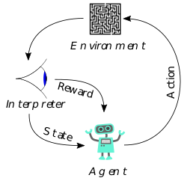
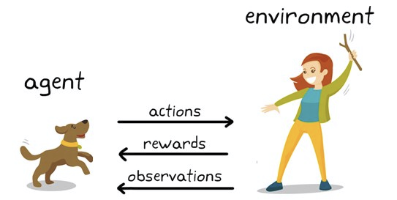
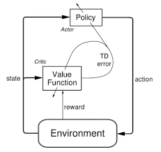
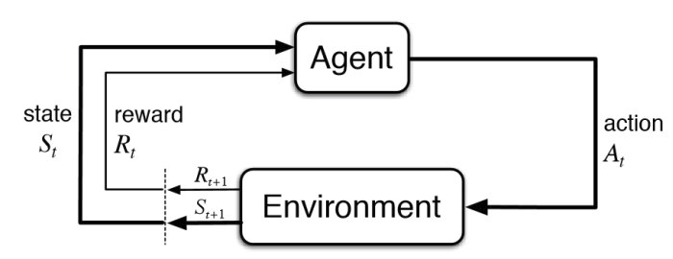
What is Reinforcement Learning?
Rhetorical Question: which of these is RL?
Answer: all of them.

Slide 5
What is Reinforcement Learning?
What differences do you see between these representations of RL?
This is the same for the real world!
You act
This can change some aspects of the environment
The environment rewards you, your teacher rewards you, or you reward yourself

Slide 6
What is Reinforcement Learning?
In many simple environments like the OpenAI gym environments, the interpreter is part of the environment. The environment gives you the reward and the next state.
We’ll explore the RL problem using this representation. This is because the interpreter can be:
Part of the environment
Its own thing
Part of the agent

Slide 7
Stochastic vs Deterministic
State transition: s, a -> s’
Deterministic: s, a -> one s’ with 100% certainty.
Stochastic: s, a -> multiple possible s’ with their own probabilities

Slide 8
Stationary vs Non-stationary
We take a stochastic state transition: s4, a1 -> [80% s5, 20% s4]
If taking action a1 from state s4 always gives an 80% chance of going to s5, and a 20% chance of staying in s4, this transition is stationary.
If these probabilities change (or s4, a1 leads to a new state altogether), the problem is non-stationary. These changes can occur over time or when specific conditions are met.
These properties are independent of the deterministic and stochastic properties.

Slide 9
Discrete vs Continuous
Both actions and states can be discrete or continuous.
Discrete: Actions like Up, Down, Left, Right in Pacman States like the position of the agent in a 5x5 grid
Continuous: Actions like throttle percentage or steering angle States like x, y, z floating point coordinates in a game world or GPS coordinates in the real world.
Discrete and continuous states and actions can be mixed, and often are in more complex environments.

Slide 10
Episodic vs Continuing
An environment can be episodic or continuing.
Episodic: Divides naturally into episodes; each episode has a clear start and a clear end. Learning can occur at the end of each episode. (But it isn’t limited to that of course.)
Continuing: The task is essentially one episode with no clear start and no clear end; the agent must learn while interacting with the environment.

Slide 11
Environments wrap-up
Part of the goal of RL is to learn to solve all kinds of environments that have mixes of
Discrete and continuous states and actions
Stationary and Non-stationary transitions
Deterministic and Stochastic transitions
This is because real life is often like this.
Or is it?
This is a subject of metaphysical debate, but we are not here for that. For us it is like this, because of the mathematical framework we use to do RL.

Slide 12
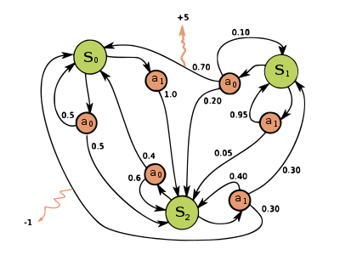
Markov Decision Process (MDP)
The mathematical model that most of RL is based on.
If you can turn your problem into an MDP, you can use RL on it.
Everything in this presentation so far has been based on MDP’s or extensions of the standard MDP.
From states you can take actions that lead you to other states.
What are the numbers next to the state transition arrows? And the numbers next to the orange arrows?
State transition numbers: probabilities Orange arrow numbers: rewards

Slide 13
The Markov Property
MDP’s have one underlying assumption: the Markov Property.
Definition of Markov Property: The next state only depends on the current state and the action you take.
This means that previous states do not have to be remembered when choosing an action.
This sounds very limiting; we very often do things that require a memory of previous states. How can you make problems like these satisfy the Markov property?
Split each state up into different states depending on how you get there. Then the information you needed to remember is contained in the state you are in, and the Markov property is satisfied again.

Slide 14
Large MDP’s and practical constraints
If we split up our states into a huge amount to satisfy the Markov property, that creates a lot of states that have a lot of state transitions. Our MDP becomes really large.
Large MDP’s lead to a practical challenge: The amount of possible decisions to be taken increases. This makes finding the best possible solution harder or even impossible.
There are two big trade-offs in this area of practical constraints:
Generalization vs Discrimination trade-off
Exploration vs Exploitation trade-off

Slide 15
Generalization vs Discrimination trade-off
Generalization: use information gathered in one state to adjust behaviour of a different state. This can decrease the amount of training needed, at a cost to performance that correlates with how different the generalized states are.
100% Discrimination increases training time needed but gives better performance than generalization.
An agent that generalizes where it can and discriminates where it must is an agent that performs almost as good as its discriminating counterparts at a hugely reduced training time.

Slide 16
Exploration vs Exploitation trade-off
Exploration: choosing actions to gain more information
Exploitation: choosing actions to maximize rewards now
Exploit to do as well as you can now, and explore to hopefully find a better action to take to get more reward in the future.
You can’t do both at once, so you need to balance them.
The more you can target exploration towards states that are the least known to the agent, the more efficient exploration becomes. This reduces the time required for training.

Slide 17
Break
Take a break or ask some questions!

Slide 18
Q-learning
Now that we have discussed what properties environments can have and what MDP’s are useful for, we will dive into the theory of the RL agent.
We are going to do that using the well-known Q-learning algorithm.
But first...

Slide 19
The general anatomy of an online RL algorithm
An RL agent consists of:
A value function or value function approximator.
Table
Neural network
A policy that uses this value function or approximator to produce an action when given a state.
A learning loop where each step:
An action is taken according to a Policy, reward and next state observed
The expected reward from the value function/approximator is compared with the actual reward (the difference In this is called the “error”).
The error is used to update the value function in the direction of the actual reward found. Stop when converges.

Slide 20
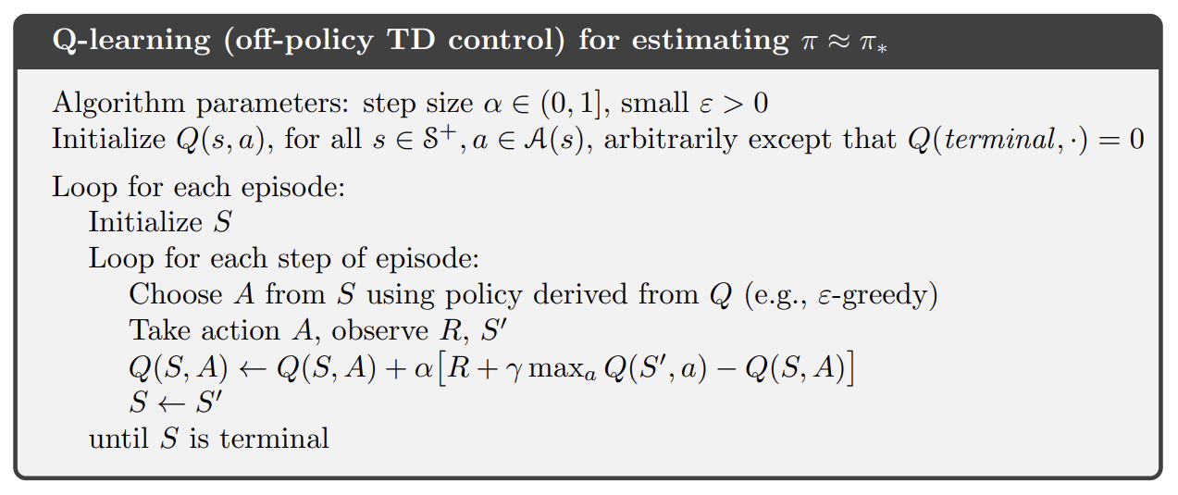
What is Q-learning?
Analyse the pseudocode. What do you see?
Parameters: 𝛼, 𝜀, 𝛾 Something called Q(s,a) to initialize
Inside the learning loop:
An action is taken according to a policy derived from that Q called 𝜀-greedy. R and S’ are observed.
Q is updated according to this new data.
Until S is the final state.

Slide 21
RL algorithms
Something called Q(s,a) to initialize
Inside the learning loop:
An action is taken according to a policy derived from that Q called 𝜀-greedy. R and S’ are observed.
Q is updated according to this new data.
Until S is the final state.
Policies
On-policy vs off-policy
𝜀-greedy exploration
Q-learning: on- or off-policy?
What is Q(s,a)? Value functions
Temporal difference learning
The TD error

Slide 22
Policies
An RL agent has one policy or multiple policies.
A policy is a rule by which an agent selects an action based on a given state.
Deterministic policy: 𝜋(s) = a Stochastic policy: 𝜋(a|s) where: 𝛴_{a∈A(s)}𝜋(a|s) = 1, and 𝜋(a|s) ≥ 0
This is a policy on an MDP. Policies choose actions only based on given state s. (Markov property.)
Remember Markov Property slide: s must contain all information required to be able to make the right decision, so we can ignore all previous states.

Slide 23
On-policy vs off-policy learning
An RL agent has one policy or multiple policies.
A policy is a rule by which an agent selects an action based on a given state.
Deterministic policy: 𝜋(s) = a Stochastic policy: 𝜋(a|s) where: 𝛴_{a∈A(s)}𝜋(a|s) = 1, and 𝜋(a|s) ≥ 0
On-policy learning: The agent has one policy. It improves that policy with information gathered by following that same policy.
Off-policy learning: The agent has multiple policies. Usually: Behaviour policy b(a|s) is used to explore the environment, and target policy 𝜋(s) = a selects actions greedily, after learning from the information gathered by b.

Slide 24
The 𝜀-greedy policy
How it works -
𝜀-greedy action given s, Q(s,a) and 𝜀 ∈ (0, 1]:
Take a random number between 0 and 1.
If that number < 𝜀: Choose random action Else: Choose the best action for s using the current values in Q(s,a)
This is a policy commonly used for balancing exploration and exploitation.
It is simple and flawed, but it is popular because it works with Deep RL.
There are many better policies for more targeted exploration in tabular environments, a quick web search will give you good results.

Slide 25
Is Q-learning on- or off-policy?
Off-policy!
The behaviour policy b(a|s) is 𝜀-greedy (or something else that always continues exploring).
The greedy target policy 𝜋 = argmax_{a}Q(s,a) is being improved using action values taken from a greedy policy.

Slide 26
What is Q(s,a)? Value functions
State-value function:
v_{𝜋}(s) ≝ 𝔼_{𝜋}[ G_{t} | S_{t}= s ]
The value of a state in policy 𝜋 is the expected return in that state according to that policy.
Action-value function:
q_{𝜋}(s, a) ≝ 𝔼_{𝜋}[ G_{t} | S_{t}= s, A_{t}= a ]
The value of a state-action pair in policy 𝜋 is the expected return from taking that action from that state according to that policy.
These value functions can be rewritten as the state-value and action-value Bellman equations, which makes them usable for computations. We only need the intuition for now though.
Q(s,a) contains these q_{𝜋}(s, a) values for each state-action pair.

Slide 27
Temporal difference learning
The value update step of Q-learning uses temporal difference learning. This refers to learning using the TD error. TD learning is an online learning method: it adjusts the value function (in our case Q(s,a)) on each step, during play.
TD update: Q(S_{t}, A_{t}) ← Q(S_{t}, A_{t}) + ⍺ (R_{t+1} + 𝛾 Q(S_{t+1}, A_{t+1}) - Q(S_{t}, A_{t}))
New value of (S_{t}, A_{t}) = Current value of (S_{t}, A_{t}) + step size * TD error.
So we adjust the value of our state action pair by step-size * TD error.
⍺ = step size, how much the TD error changes the state-action value.
TD error?

Slide 28
The TD error
TD error: (R_{t+1} + 𝛾 Q(S_{t+1}, A_{t+1}) - Q(S_{t}, A_{t}))
R_{t+1} is the reward immediately granted
𝛾 is a discount factor
Q(S_{t+1}, A_{t+1}) is the value of the next state
Minus Q(S_{t}, A_{t}), the current value of the current state.
R_{t+1} + 𝛾 Q(S_{t+1}, A_{t+1}) is the reward received for reaching the next state plus the discounted future reward we expect from the next state.
Q(S_{t}, A_{t}) is the reward we expected to receive when acting A_{t} from state S_{t}
The difference or error between the two is the temporal difference error.
TD seems to be the error function used in the brain, communicated by dopamine.

Slide 29

Challenge: Q-learning

Slide 30
Time to code!
Q-Learning Challenge
Examine the Taxi-v3 environment
Implement epsilon-greedy exploration
Write the TD update
Do the parameter study
Optional
Examine the FrozenLake-v0 environment
Do the second parameter study

Slide 31
Break
Take a break or ask some questions!

Slide 32
Q-learning wrap-up
Can your agent solve both environments?
Which optimal parameters did you find?
Was it fun?

Slide 33
Tabular vs Non-Tabular Q-learning
In tabular Q-learning the value of each state-action pair is contained in a large table. During the learning process these values are updated until they converge to their true values.
It is also possible to assign the same table entry to a number of states to increase generalization at the cost of discrimination. This is called “state aggregation”.
A tabular algorithm can only deal with a finite amount of discrete states and actions. Continuous states have to be aggregated.
In non-tabular Q-learning the values of state-action pairs are not contained in a table. Deep Q-learning is an example of non-tabular Q-learning: the deep neural network approximates the value of the observed state-action pair.
Deep RL is trickier than tabular RL, but it works on continuous states and actions in environments with infinite variety.
For this session we stuck to tabular RL.

Slide 34
Online vs offline learning
Online: update value function/parameters of policy on each timestep. Works in continuing and episodic tasks.
TD learning
Offline: Gather data by playing an entire episode. Update value function/parameters of policy after a completed episode using the found state-action pairs and rewards.
Monte Carlo simulation

Slide 35
Continuing your RL journey

Slide 36
What now?
You have learned and applied many fundamental concepts of RL in a tabular setting.
Some more aspects of the RL problem
Cool research
Further learning resources

Slide 37
The general anatomy of an online RL algorithm
An RL agent consists of:
A value function or value function approximator.
Table
Neural network
A policy that uses this value function or approximator to produce an action when given a state.
A learning loop where each step:
An action is taken according to a policy.
The expected reward from the value function/approximator is compared with the actual reward (the difference In this is called the “error”).
The error is used to update the value function in the direction of the actual reward found. Stop when converges.

Slide 38
The general anatomy of an offline RL algorithm
An RL agent consists of:
A value function or value function approximator.
Table
Neural network
A policy that uses this value function or approximator to produce an action when given a state.
An entire episode is played and stored.
A learning loop where each step:
A datapoint is taken from the data buffer.
The expected reward from the value function/approximator is compared with the actual reward.
That error is used to update the value function in the direction of the actual reward found. Stop when converges.

Slide 39
Completely vs Partially Observable
If an environment is completely observable, that means that the observation the agent receives is the same as the actual state of the environment.
Sometimes information about the state of the environment is hidden from the agent. Then the environment is partially observable.

Slide 40
Dealing with sparse rewards
If an environment has many states and the route to a reward is very long, we speak of an environment with sparse rewards.
Adjusting the values of states or state action pairs only happens when a reward is reached: then you can say that that state or state action pair brings you closer to a reward.
The problem with sparse reward environments is that reaching a reward through the usual random exploration is very unlikely.
Solutions to this include:
Preferring exploration of states that are the least explored
Adding rewards to the environment
Combining both (curiosity algorithms)

Slide 41
Cool research
A small selection of some of my favorite RL research.
Deepmind MuZero can generalize over chess, go and atari games using Deep RL and Monte Carlo Tree Search.
Curiosity driven exploration is a very cool way of dealing with sparse reward environments.
Deepmind researchers also found that given the same inputs and outputs as the navigation centre of a rat brain, artificial neurons learn the same type of activity as those rat neurons.
Deepmind MuZero http://www.furidamu.org/blog/2020/12/22/muzero-intuition/
Curiosity driven exploration https://pathak22.github.io/noreward-rl/
Deep RL agents navigating like animals https://deepmind.com/blog/article/grid-cells

Slide 42
Further learning resources
To master RL I can recommend reading Sutton & Barto’s book, you can find it on the github page. (I am allowed to redistribute it as-is for free for non-commercial purposes according to the license.) What you have learned today is mostly from this book, so you will have a nice head start.
Google and youtube also work, as well as sites like coursera.
In Q4 of this academic year I am doing a track similar to this ML bootcamp, which will cover Deep RL, so RL with deep neural networks. Subscribe to the newsletter on fruitpunch.ai or join connect.fruitpunch.ai to receive a sign up link when the time comes.

Slide 43
Thank you, and good luck on your journey!
✕
Dani Christiaans for FruitPunch AI’s ML Bootcamp, 10-1-2021, brought to you by TU/e

